Slide 1

Online Food Delivery Service
👩‍💻 Prepared by: Heba Mohamed – Sara Mahrous

Slide 2

The company has various amounts of data on customers, drivers and orders, but it's not fully used effectively. Without analyzing this data, it's difficult to know:
1-Which items sell best.
2-Drivers and delivery date for each area.
3-Customers' payment methods.
4-Regions where orders are most frequently placed.
Therefore, the project aims to analyze the data to understand requirements, evaluate performance, and help the company improve operations and customer satisfaction.

Slide 3
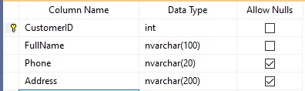
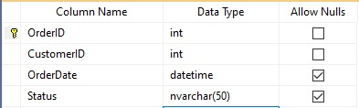
Customer: Contains customer information such as customer ID, name, email, phone number, and address.
Order: Contains order information such as order ID, order date, status.

Slide 4
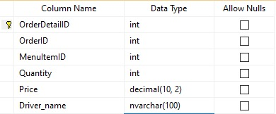
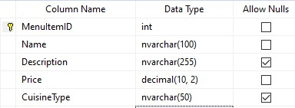
OrderDetails: contains details of the order as MenuItemID, Quantity, Price and DriverName
MenuItems: contains menu details as ItemName, Price, CuisineType

Slide 5
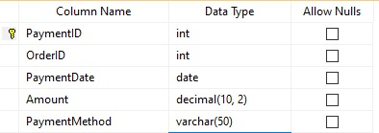
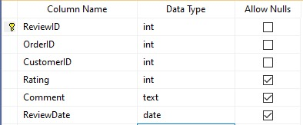
Payments: Contains Payment information as PaymentDate, PaymentMethod, Amount
Reviews: Contains Reviews information as Rating and ReviewDate

Slide 6

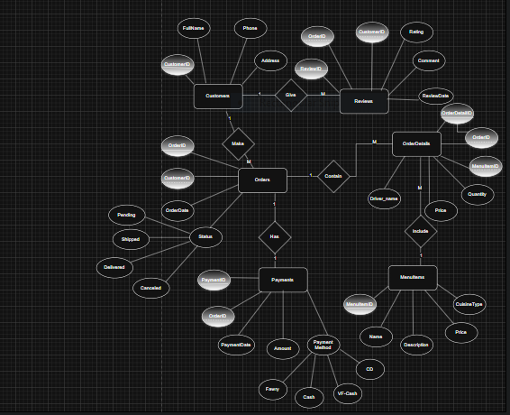
Relations Between Tables
One Customer Can Make Many Orders
One Customer Can Give Many Reviews
One Order Can Contain Many OrderDetails
One Order Has One Payment
One MenuItem Include Many OrderDetails

Slide 7
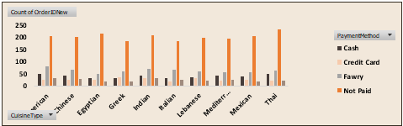
Main Insights
1. Orders Distribution by Cuisine & Payment Method
Orders are fairly evenly distributed across cuisines (Chinese, Egyptian, Greek, Indian, etc.).
Not Paid is by far the most dominant payment method compared to others because shipped , canceled and pending orders are the most dominant status compared to delivered one.

Slide 8
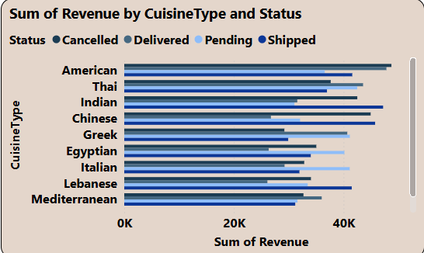
American cuisine generates the highest revenue (~46K).
Indian and Chinese cuisines follow closely with revenues around 44–45K.
Thai and Lebanese cuisines perform at a mid-to-high level (~40–42K).
Mediterranean cuisine records the lowest revenue (<35K).
Across all cuisine types, Shipped orders contribute the most to revenue, followed by Delivered.
Pending orders show a moderate contribution, while Cancelled orders consistently account for the smallest share.
Overall, the dominant trend is that Shipped and Delivered orders drive the majority of revenue.

Slide 9
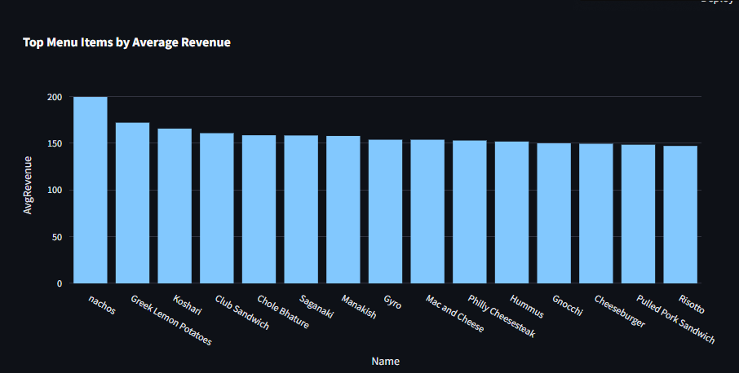
Nachos are the clear revenue leader → could be promoted more aggressively (bundles, featured item).
Egyptian dish (Koshari) also ranks among the top items, aligning with earlier findings that Egyptian cuisine performs strongly.
Menu diversity (Greek, American, Middle Eastern, Italian, Indian) shows that no single cuisine dominates across all items — revenue is spread across international dishes.
Mid-tier items maintain steady contribution → good base for sales stability.

Slide 10
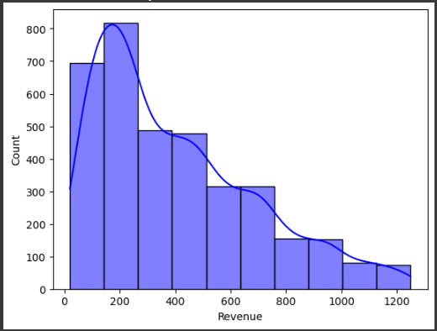
Revenue distribution is right-skewed – most restaurants generate lower to mid-level revenues.
Majority of revenues are below 500 – indicating moderate earnings for most restaurants.
Few high performers – only a small number of restaurants achieve revenues above 1000.
Business implication – the market is dominated by medium-revenue restaurants, while high-revenue ones are rare and may need special strategies.

Slide 11
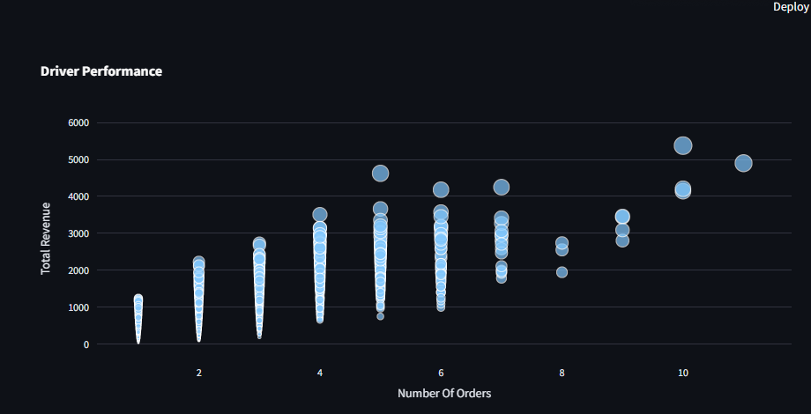
There is a positive correlation: as the number of orders completed by a driver increases, total revenue also rises.
Drivers with low order counts (1–3 orders) generate relatively low revenues, mostly below 2,800.
Mid-level drivers (4–7 orders) show a wider revenue range, with several generating between 3,000–4,500.
Top drivers (8–10+ orders) achieve the highest revenues, peaking close to 6,000.
The bubble sizes vary, indicating differences in revenue contribution – some drivers generate significantly higher earnings despite similar order counts.
Overall, revenue performance is driven by order volume, with drivers handling more orders consistently achieving higher revenues.

Slide 12


